Slide 1
1. Teacher Instructions
Title: Case study: Toowoomba
Length: Approximately 2 x 60 minutes lessons
Description: Students explore the controversies surrounding recycled water by considering the dilemma facing Toowoomba in 2006.
Students evaluate the use of referendums.
Students analyse three sources from the 2006 Toowoomba referendum.
Students research the use of potable recycled water from around the world at a selected location.
Overview:
Understand that the use of science and technology to address issues such as water shortages, may have social and ethical implications
Investigate other cities that already use recycled water
***See Notes on each slide for more teaching notes and ideas***

Slide 2
Instructions
The following is a suggested sequence of activities and time allocation. You might want to spend more or less time on specific sections depending on your class and their learning requirements. All resources can be edited to suit your teaching needs.
Slide | Description | Time
1.1: Introduction | Students think about purified recycled drinking water | 10 minutes
1.2 – 1.4: Case Study: Toowoomba | An introduction into the referendum in Toowoomba about recycled water | 10 minutes
1.5: Campaign analysis | Students analyse the campaign of the ‘for’ and ‘against’ | 10 minutes
1.6: Referendum results | Discussion about the results of the referendum | 10 minutes
1.7: Recycled water use around the world | Student task where they investigate/ learn about recycled water use around the world | 80 minutes

Slide 3
Case study: Toowoomba
How can the Western Treatment Plant help Melbourne to thrive and adapt to an uncertain future?

Slide 4
Learning outcomes
Describe how water is a renewable natural resource that is finite
Identify the different factors that contribute to water variability and the impacts of water scarcity
Explain the different methods to overcoming water scarcity, by reducing demand and increasing the supply of water
Understand that Melbourne's water resources will be impacted by climate change
Know that the liveability of Melbourne depends on a safe and secure supply of water and treatment of wastewater

Slide 5
1.1: Introduction - purified recycled drinking water
Starter: Write down what you think about when you consider purified recycled drinking water?
Notes:
Teacher notes & ideas
Image: Western Treatment Plant
Get students to respond to this question. They can work alone, in pairs or small groups to write down their responses. Then share the ideas with the class.
Students may come up with many different ideas and words.
You could also ask the students have they visited a city where they use purified recycled drinking water. They may not know – see slide 12 for a map showing these cities.

Slide 6
1.2: Case study: Toowoomba
In the mid 2000s, the residents of Toowoomba in south-east Queensland were struggling through the Millennium Drought and some of the toughest water restrictions in the country.
Water restrictions began in 2003 and by 2006 the town was on level 4 water restrictions, lawns were brown and cars were dusty. Water storage levels were at 20% and were predicted to drop to 5% within two years. There was no sign of the drought ending.
Notes:
Teacher notes & ideas

Slide 7
1.3: Case study: Toowoomba
In July 2005 the Toowoomba council announced a number of water solutions, including the building of a waste treatment plant to add recycled sewage that was drinking quality to the town’s water stores.
Within a month a campaign group had formed to oppose the proposal. For almost a year the community debated the proposal and progress stalled.
In March 2006, the federal government announced that the residents of Toowoomba would be given an opportunity to vote on the proposal.
The Toowoomba local council objected to the referendum. They argued that they had been elected to represent the community and make decisions on their behalf.
Notes:
Teacher notes & ideas

Slide 8
1.4: Case study: Toowoomba
Leading up to the referendum, the campaigning on both sides was intense across radio, television and print media.
Notes:
Teacher notes & ideas

Slide 9
1.5: Analyse the media campaign and complete the table
Source | What is the message of this source? | How does this source use text and images to persuade? | Would you find this persuasive?
1: Referendum polling day poster 1
1: Referendum polling day poster 2
2: Advertisement– A NO VOTE and a YES VOTE
Other:
Notes:
Teacher notes & ideas
See source links on next slide. You can share the links with students of download the images.

Slide 10
1.5: Sources
Source 1: Referendum polling day poster 1
Source: Toowoomba ex-mayor Di Thorley says sewage is solution to discarded water scheme
Source 2: Referendum polling day poster 2
Source: We voted no, but recycled water may still be our future | The Courier Mail
Source 3: Advertisement– A NO VOTE and a YES VOTE
Source: Anti-recycled water campaign, Toowoomba | Queensland Historical Atlas
Notes:
Teacher notes & ideas
Teacher notes & ideas
See source links on next slide. You can share the links with students of download the images.

Slide 11
1.6: Case study: Toowoomba
On the 29th of July 2006, 62% of Toowoomba voters, voted against adding treated recycled wastewater to the town’s water stores. 38% voted in favour.
Discuss: Are you surprised that the majority of people voted ‘no’?
Notes:
Teacher notes & ideas
Despite the outcome, the drought continued, and by April 2007, Toowoomba residents were living with level 5 water restrictions.
By 2010 the dams were down to 8%. Soon after a pipeline was opened that connected Toowoomba to a larger supply of water managed by the Queensland state government.
The Wivenhoe Dam pipeline provides security of supply when the rainfall in our dam catchments is insufficient to maintain supply to meet the region's growing needs. Once the capacity of Cressbrook dam falls below 40%, Toowoomba can start using water from Wivenhoe Dam.
This store of water is topped up with purified wastewater during times of drought

Slide 12
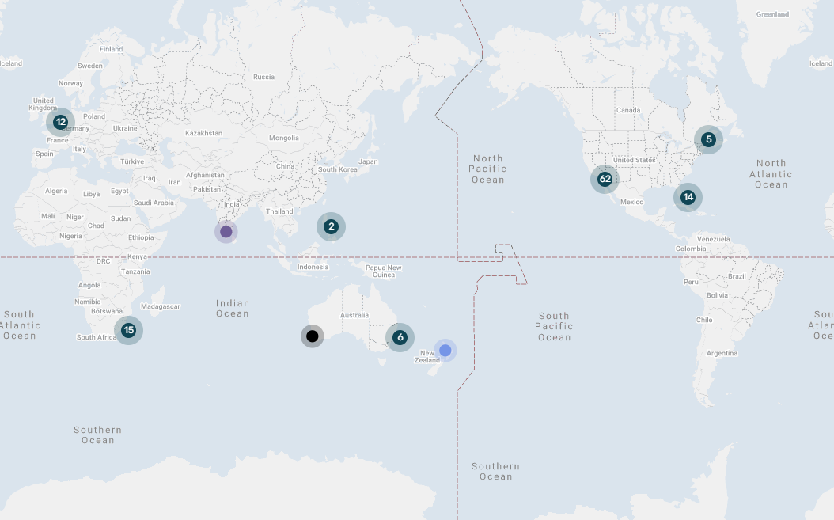
1.7: Recycled water around the world
Task: Choose one city from the map to research
Find out:
1. When and why was recycled water proposed in this city?
2. How do they use recycled water?
3. What has been the public and media reaction to the use of recycled water?
Source: Map - Water360
Notes:
Teacher notes & ideas
Step 1: Open the map either click on the image or the source
Step 2: You can allocate cities to your students, or you get them to pick the cities they want to investigate
Step 3: Decide how you what students to present the information they learn about: short report, short answer questions, poster or presentation.

Slide 13
Curriculum links
Geographical Knowledge: VC2HG8K03, VC2HG8K04
Geographical Skills: VC2HG8S02, VC2HG8S03, VC2HG8S04, VC2HG8S05, VC2HG8S06
Science: VC2S8H03, VC2S8U09

